Slide 1
OpenCv
Workshop

Slide 2
What is OpenCV
Open Source Computer Vision Library
It has more than 2500 optimized algorithms.

Slide 3

Object Identification
Gesture Recognition
Various Applications
Motion Tracking
Image Processing
Mobile Robotics
Human computer Interaction

Slide 4
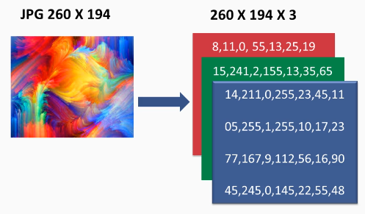
What is a Image?
Image is an array
Contains three Layers(R,G,B)
In OpenCv the organization pattern is (B,G,R)

Slide 5
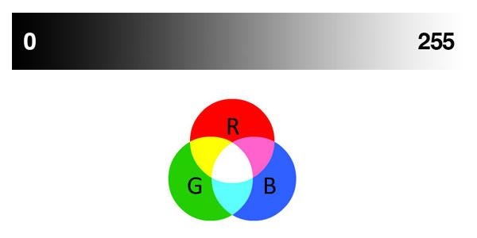
Accessing Individual Pixels
Top: grayscale gradient where brighter pixels are closer to 255 and darker pixels are closer to 0. Bottom: RGB venn diagram where brighter pixels are closer to the center.

Slide 6
Loading and displaying an image
import cv2
image = cv2.imread("image.png")
(h,w,d) = image.shape
print(“width={},height ={},depth ={}”.format(w,h,d))
cv2.imshow(“Image”,image)
cv2.waitKey(0)

Slide 7
Resizing Images
Lets resize a image to 200*200 pixels
resized = cv2.resize(image,(200,200))
cv2.imshow(“Fixed Resizing”,resized)

Slide 8
Converting to GrayScale
Why GrayScale?
It reduces the three dimensional array to one dimension
Makes calculation easier and faster
cv2.cvtColor(image,cv2.COLOR_BGR2GRAY)

Slide 9
Let’s Smooth the image
GaussianBlur
cv2.GaussianBlur(image,(5,5),0)

Slide 10

Finding the Edge of the grayed image
Canny(image,min_thres,max_thres)
cv2.Canny(gray,75,200)

Slide 11
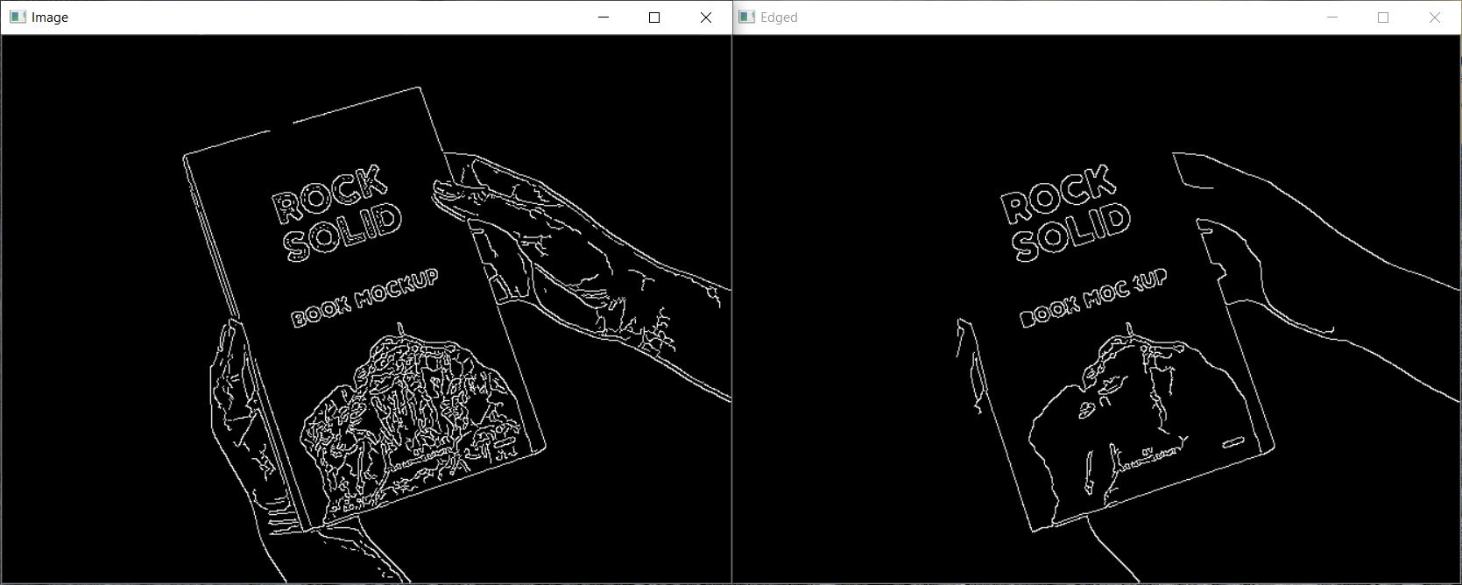
Finding the Edge of the grayed image
(10,50)
(50,150)

Slide 12
Inverting the background
Used to get a bi-level image out of grayscale image
cv2.threshold(src,thresh,maxval,type)
cv2.threshold(gray,255,255,cv2.THRESH_BINARY_INV)[1]

Slide 13
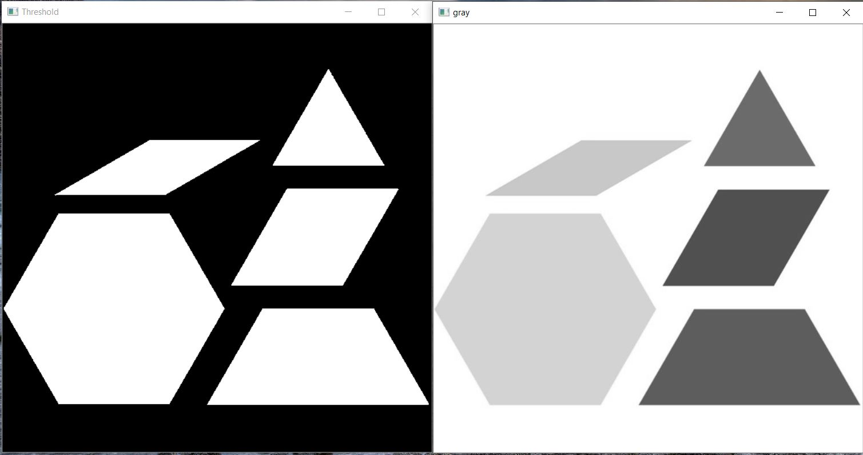
Inverting the background

Slide 14
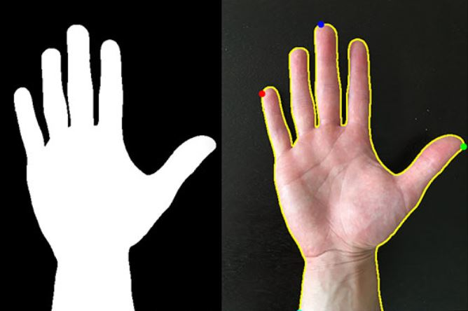
Contour
Contours are defined as the line joining all the points along the boundary of an image that are having the same intensity.

Slide 15
Contour
cv2.findContours(thress.copy(),cv2.RETER_eXTERNAL,cv2.CHAIN_APPROXIMATION_NONE)
//This will find contours

Slide 16
Imutils
pip install imutils
conda install pip
Then use pip to install imutils:
pip install imutils

Slide 17
Grab the contours
Contur = imutils.grab_contours(contur)

Slide 18
Now, Display the Contour
for c in contur:
cv2.drawContours(image,[c],-1,(240,55,159),3)
cv2.imshow(“Contours”,output)

Slide 19
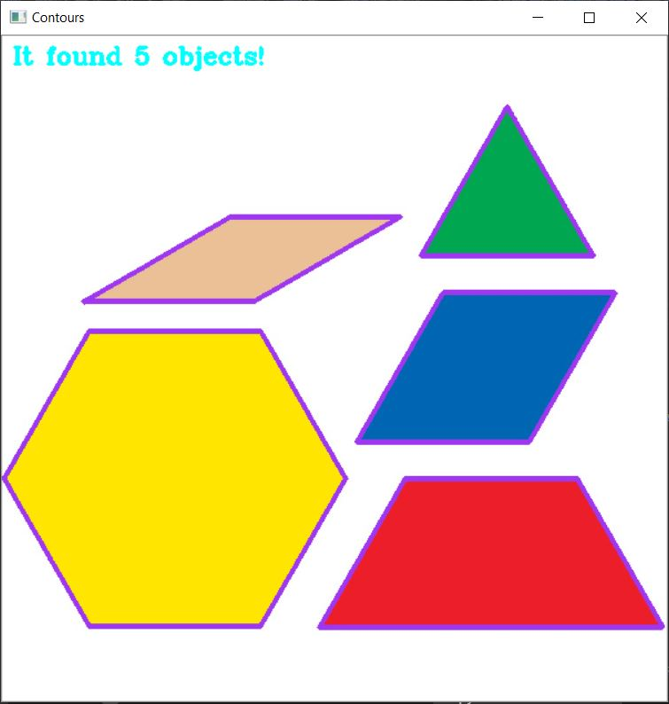
Now, Display the Contour

Slide 20
Hold the image and clear the cache
cv2.waitKey(0)
cv2.destroyAllWindows()

